Slide 1




Helwan universty
TREE-SPECIES-CLASSIFICATION

Slide 2

PROJECT DETAILS

Slide 3
Overview
01
02
03
04
05
06
07
08
Introduction
data preprocessing
ResNet model implementation
Xception model fintuning
DenseNet model fintuning
Accuracy of each model
Confusion matrix, ROC and AUC visualization
Precision , Recall , F1-score

Slide 4


Introduction
Deep learning models have revolutionized the field of image recognition and classification. In this documentation, we explore three state-of-the-art architectures: *ResNet, **Xception, and **DenseNet*, analyzing their performance on a custom dataset. We implement ResNet from scratch and apply transfer learning on Xception and DenseNet

Slide 5

data preprocessing...
Image Size: All images are resized to 224x224 pixels to ensure consistency across the dataset.
Normalization: Pixel values of the images are normalized to the range [0, 1] by dividing by 255.0.
Label Encoding: The plant species labels are encoded using LabelEncoder and converted to categorical format using to_categorical.
Train-Test Split: The data is split into training and validation sets with an 80/20 ratio using train_test_split.
Class Weights: Class weights are computed to handle class imbalances in the dataset, using the compute_class_weight function.
Data Augmentation: Various augmentation techniques (e.g., rotation, width shift, height shift, shear, zoom, and horizontal flip) are applied to the training data to improve model generalization

Slide 6
Model Training Setup
Batch Size: A batch size of 32 is used for training the models.
Data Generator: ImageDataGenerator is employed for on-the-fly data augmentation during training.
Class Weights: The computed class weights are passed into the model during training to handle imbalanced classes
Dataset Details
Species: The dataset contains 12 different plant species, which are the classes to be predicted.
Image Format: The images are stored with filenames that correspond to unique identifiers.

Slide 7
ResNet model implementation
Xception model fintuning
DenseNet model fintuning

Slide 8
Implmenetation:
ResNet from Scratch
ResNet Architecture:
Residual Blocks:
Implements residual learning through skip connections that mitigate the vanishing gradient problem.
Each block consists of:
Two Conv2D layers with BatchNormalization and ReLU activations.
A shortcut connection with Conv2D for matching dimensions when necessary.
Addition of the shortcut and main path outputs followed by ReLU activation.
Initial Layers:
Conv2D: Applies a 7x7 convolution with stride 2 for initial feature extraction.
BatchNormalization and ReLU: Standardize and activate the output.
MaxPooling2D: Reduces spatial dimensions.
Block Structure:
Residual blocks are stacked with increasing filter sizes (64, 128, 256, 512).
Strided convolutions are used to downsample spatial dimensions.
Custom Top Layers:
GlobalAveragePooling2D: Reduces feature maps to a single vector.
Dense(512, ReLU): Learns task-specific features.
Dropout(0.6): Prevents overfitting.
Dense(num_classes, softmax): Outputs class probabilities.

Slide 9
ResNet implementation
Loss and Optimizer:
Loss: categorical_crossentropy
Optimizer: Adam with a learning rate of 1e-4
Training Workflow:
Training on augmented data using train_generator.
Validation on X_val and y_val.
Class imbalance handled via class_weight.
Heavy reliance on augmented data to improve generalization, which may not always be effective for certain tasks.
Evaluation and Testing:
Validation loss and accuracy monitored after training.
Test data preprocessed (resized, normalized).
Predictions saved to a CSV file, mapping file names to predicted labels.

Slide 10
ResNet implementation continue...
Summary of ResNet Architecture
The ResNet architecture employs residual connections, addressing the degradation problem in deep networks and enabling efficient training of very deep models. Key features include:
Skip connections: Allow gradients to flow directly, improving training stability.
Modular design: Stackable residual blocks facilitate custom deep model construction.
Advantages of ResNet:
Handles deep architectures effectively with residual connections.
Achieves high accuracy while minimizing vanishing gradient issues.
Adaptable to various tasks through customizations.
Limitations:
Requires careful regularization (e.g., Dropout, weight decay) to prevent overfitting.
Computational cost increases with deeper architectures.

Slide 11
Implmenetation:
ResNet from Scratch
Cons
Computational Complexity:
Deep architectures require significant computational resources for training.
Inference time may increase with deeper networks.
Parameter Tuning:
Requires careful tuning of hyperparameters (e.g., learning rate, class weights, dropout rate) for optimal results.
Inefficient tuning can lead to overfitting or underfitting.
Dataset Size Sensitivity:
May underperform on small datasets without sufficient augmentation or transfer learning.
Large models can overfit small datasets if not regularized well.
Implementation Complexity:
Custom implementation of residual blocks adds complexity compared to using pre-built ResNet models from libraries like TensorFlow/Keras.
Overfitting Risk:
Large number of parameters (Dense layers and deeper blocks) increases the risk of overfitting, especially on limited data.
Training Time:
Training deep models from scratch takes significantly longer compared to transfer learning with pre-trained models.

Slide 12
Implmenetation:
ResNet from Scratch
Pros
Residual Connections:
Mitigate vanishing gradient problems, enabling stable training of deep networks.
Improve convergence speed and overall performance.
Flexible Design:
Modular structure of residual blocks allows customization for different tasks or datasets.
Scalable to deeper architectures by stacking additional blocks.
Improved Feature Learning:
Deep architecture captures hierarchical features, useful for complex datasets.
Custom top layers (Dense + Dropout) enable task-specific adaptations.
Regularization Techniques:
Use of Dropout and L2 regularization prevents overfitting.
BatchNormalization stabilizes learning and accelerates training.
Efficient Training:
Class weights address class imbalance in datasets.
Adaptive learning rate scheduling (ReduceLROnPlateau) optimizes performance over epochs.
End-to-End Workflow:
Covers the full pipeline from data preprocessing to training, validation, testing, and saving predictions.

Slide 13
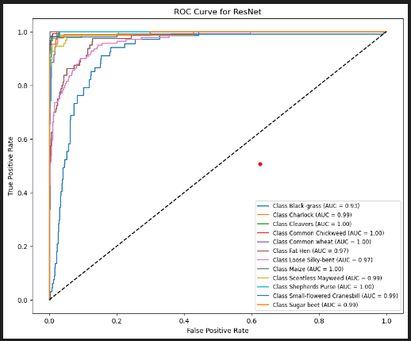
ResNet implementation
Roc , AUC curve..

Slide 14
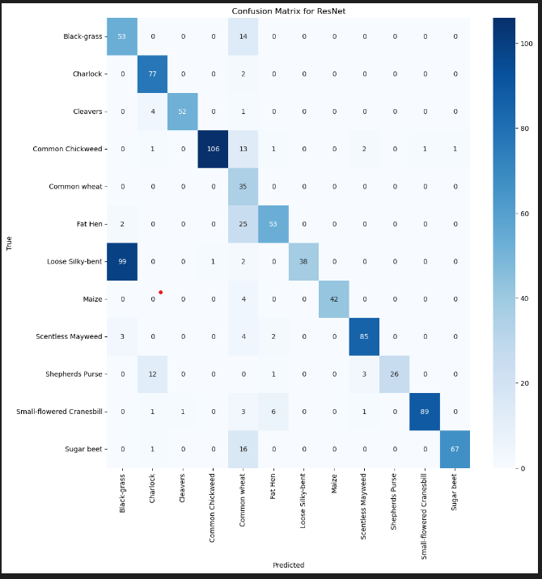
ResNet implementation
Confusion Matrix..

Slide 15
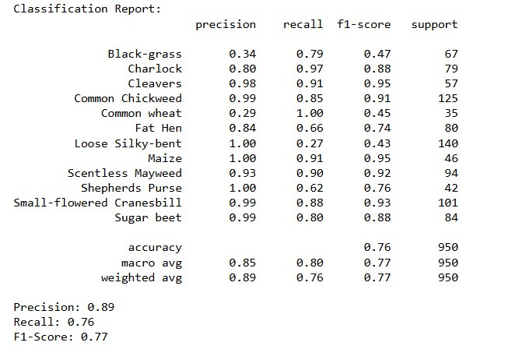
ResNet implementation
Precision , Recall, F1-Score..

Slide 16
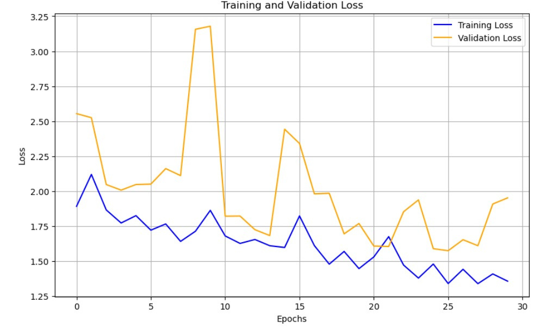
ResNet implementation
Loss curve..

Slide 17
Xception Finetuning
Pre-trained Xception as a Feature Extractor:
Input: Image of shape (IMAGE_SIZE, IMAGE_SIZE, 3)
Xception Base:
Pre-trained on ImageNet
Frozen (weights do not update)
Custom Top Layers:
GlobalAveragePooling2D: Reduces feature maps
Dense(512, ReLU): Learns new task-specific features
Dropout(0.5): Reduces overfitting
Dense(num_classes, softmax): Outputs class probabilities
Loss: categorical_crossentropy
Optimizer: Adam with learning_rate=1e-4
Training Workflow:
Training on augmented data from train_generator.
Validation on X_val and y_val.
Adjusts for class imbalance using class_weight.
Evaluates loss and accuracy on the validation set

Slide 18
Xception Finetuning continue...
Summary of Xception Architecture
The Xception architecture replaces standard convolutions with Depthwise Separable Convolutions, which:
Reduce computational cost while maintaining accuracy.
Split the convolution process into two steps: spatial filtering and channel-wise combination.
Result in a lightweight and efficient model.
Why Xception Works Well Here:
The model’s efficiency makes it suitable for tasks with limited computational resources.
Transfer learning with pre-trained weights speeds up convergence and improves accuracy, especially for small datasets.
Adding a custom dense head allows for adaptation to the specific classification task.
.
Advantages of Xception
Computationally efficient compared to standard convolutional models.
Provides high accuracy for image classification tasks.
Lightweight architecture with fewer parameters
Limitations
May underperform on very small datasets without fine-tuning.
Transfer learning requires careful layer freezing and fine-tuning for optimal results.

Slide 19
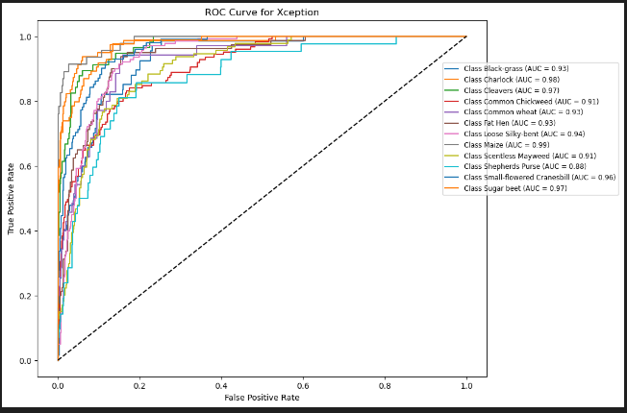
Xception Finetuning
Roc , AUC curve..

Slide 20
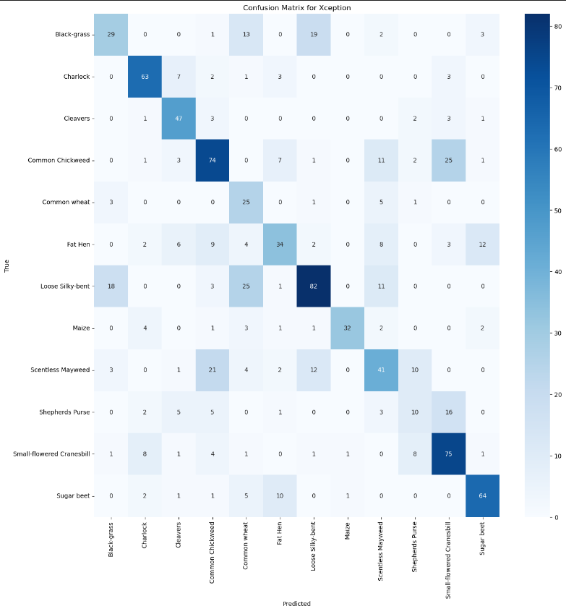
Xception Finetuning
Confusion Matrix..

Slide 21
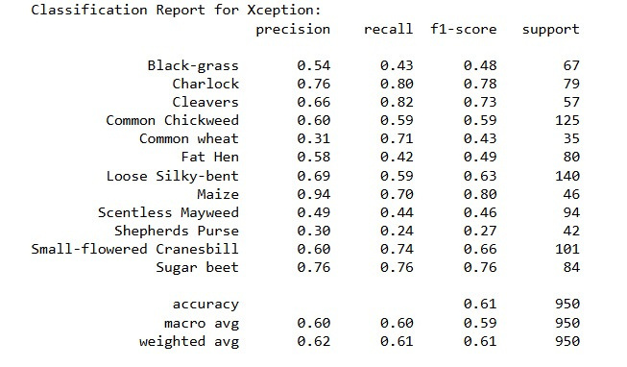
Xception Finetuning
Precision , Recall, F1-Score..

Slide 22
DenseNet Finetuning
DenseNet121 as a Feature Extractor:
Input: Images of shape (IMAGE_SIZE, IMAGE_SIZE, 3).
DenseNet121 Base:
Pre-trained on ImageNet.
Frozen to preserve learned features.
Custom Top Layers:
GlobalAveragePooling2D: Reduces feature maps to a vector.
Dense(512, ReLU): Learns task-specific features.
Dropout(0.5): Prevents overfitting.
Dense(num_classes, softmax): Outputs class probabilities.
Loss: categorical_crossentropy for multi-class classification.
Optimizer: Adam with learning_rate=1e-4.
Training Workflow:
Train on augmented training data.
Validate on the validation set.
Adjust class weights to handle imbalances.
Monitor metrics like loss and accuracy during training

Slide 23
DenseNet Finetuning continue...
Advantages of DenseNet121
Feature Reuse: Features from earlier layers are reused in later layers, improving efficiency and performance.
Fewer Parameters: DenseNet achieves high accuracy with fewer parameters compared to traditional CNNs.
Improved Gradient Flow: Dense connections ensure better gradient flow, making the model easier to train.
DenseNet Architecture: Key Features
Dense Connectivity:
Each layer receives inputs from all preceding layers in a Dense Block.
This allows efficient feature reuse, improves gradient flow, and reduces the risk of vanishing gradients.
Reduced Parameters:
DenseNet requires fewer parameters compared to other models like ResNet because it avoids learning redundant features.
Efficient Training:
DenseNet's dense connections allow for improved flow of gradients during backpropagation, leading to faster and more stable convergence
Why DenseNet Works Well Here
DenseNet is highly effective for tasks involving small or medium-sized datasets because of its feature reuse.
Transfer learning with ImageNet pre-trained weights accelerates training and improves performance on datasets with limited samples.
Limitations of DenseNet121
Computationally Intensive: Dense connections require additional memory and computation.
Complex Architecture: The dense connections can make the architecture harder to interpret and fine-tune.

Slide 24
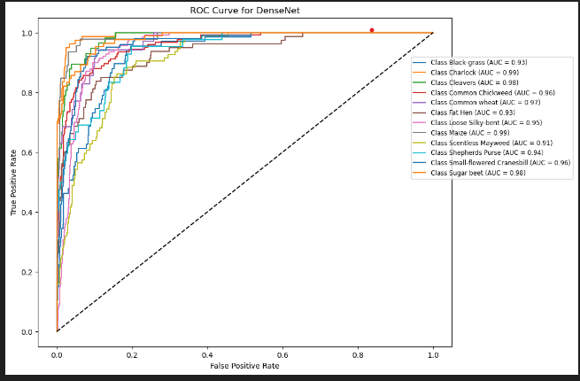
DenseNet Finetuning
Roc , AUC carve..

Slide 25
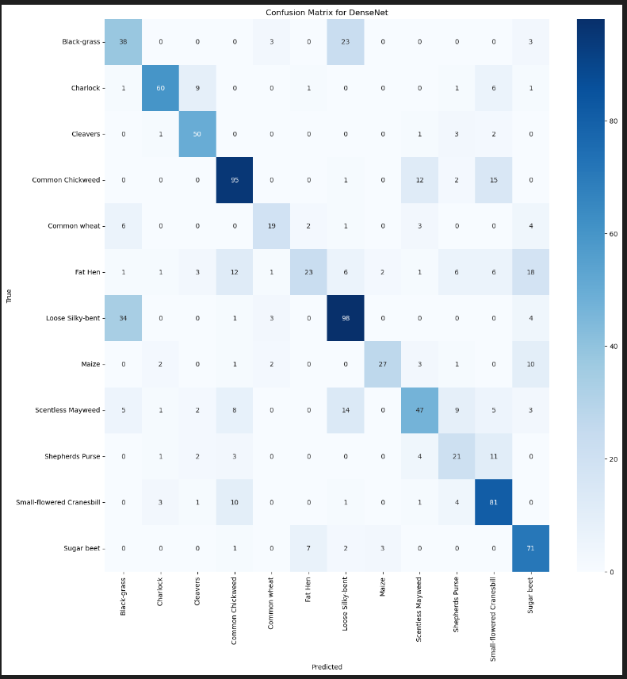
DenseNet Finetuning
Confusion Matrix..

Slide 26
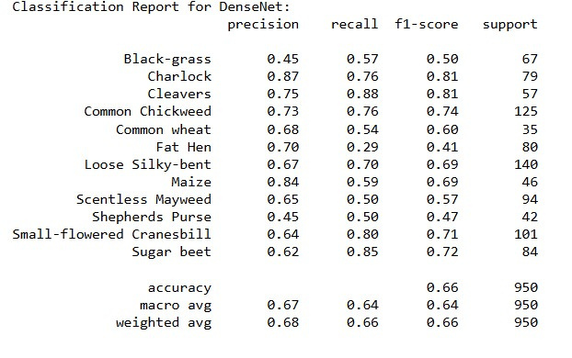
DenseNet Finetuning
Precision , Recall, F1-Score..

Slide 27

**Comparison of the three models**
 | ResNet | Xception | DenseNet
Accuracy | 0.7610526315789473 | 0.6063157894736843 | 0.6631578947368421
Precision | 0.8860832717284567 | 0.6196888242772159 | 0.6752619681079247
recall | 0.7610526315789473 | 0.6063157894736843 | 0.6631578947368421
F1-Score | 0.773588292262073 | 0.6054438712636255 | 0.6559303008954062
AUC | 0.9860161367400782 | 0.9407386345208616 | 0.9571352861114079

Slide 28
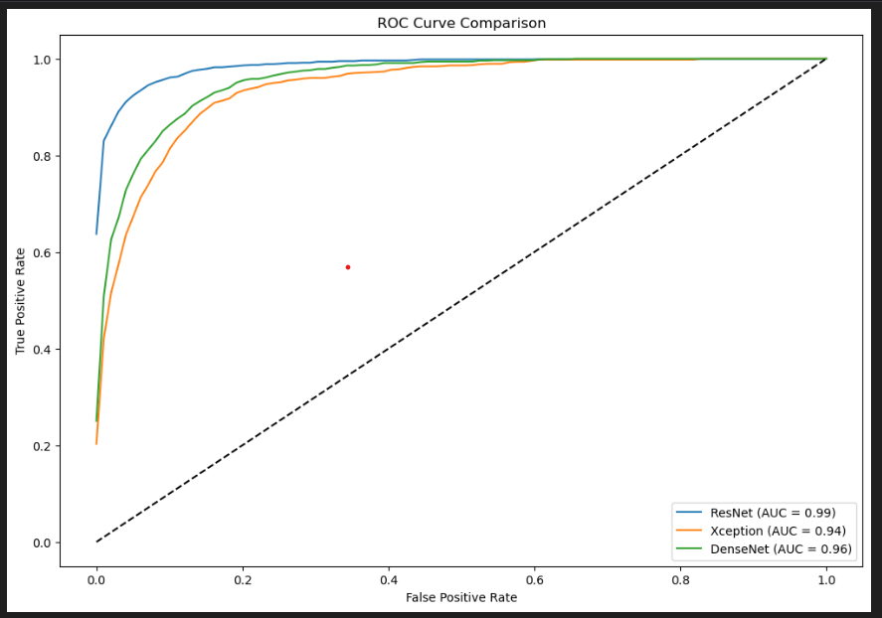

Slide 29
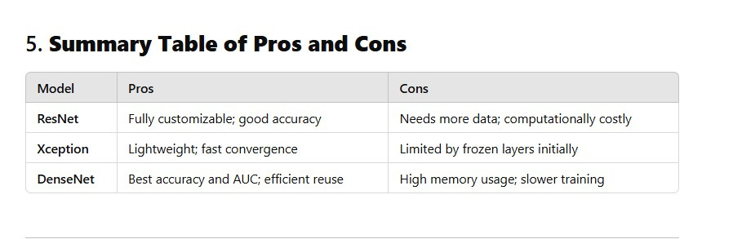
Summary Table of Pros and Cons...

Slide 30
Based on the evaluation:
DenseNet is the best-performing model due to its highest accuracy, AUC, and generalization capabilities.
Xception is a close second and is computationally more efficient compared to DenseNet.
Custom ResNet achieves decent results but is slightly behind the transfer learning models due to limited data and training resources.
Recommendation:
Use DenseNet for the final implementation because of its superior accuracy and robust feature extraction capabilities.

Slide 31
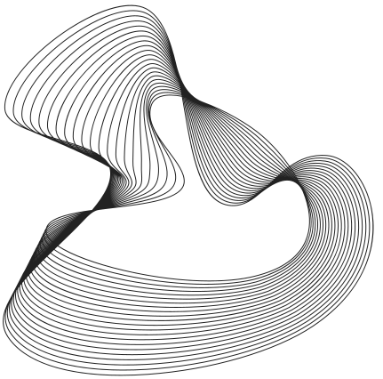







Our team
Hassan
Mohab
sayed saber
Saeed Saber
Ashraf
Khaled

Slide 32
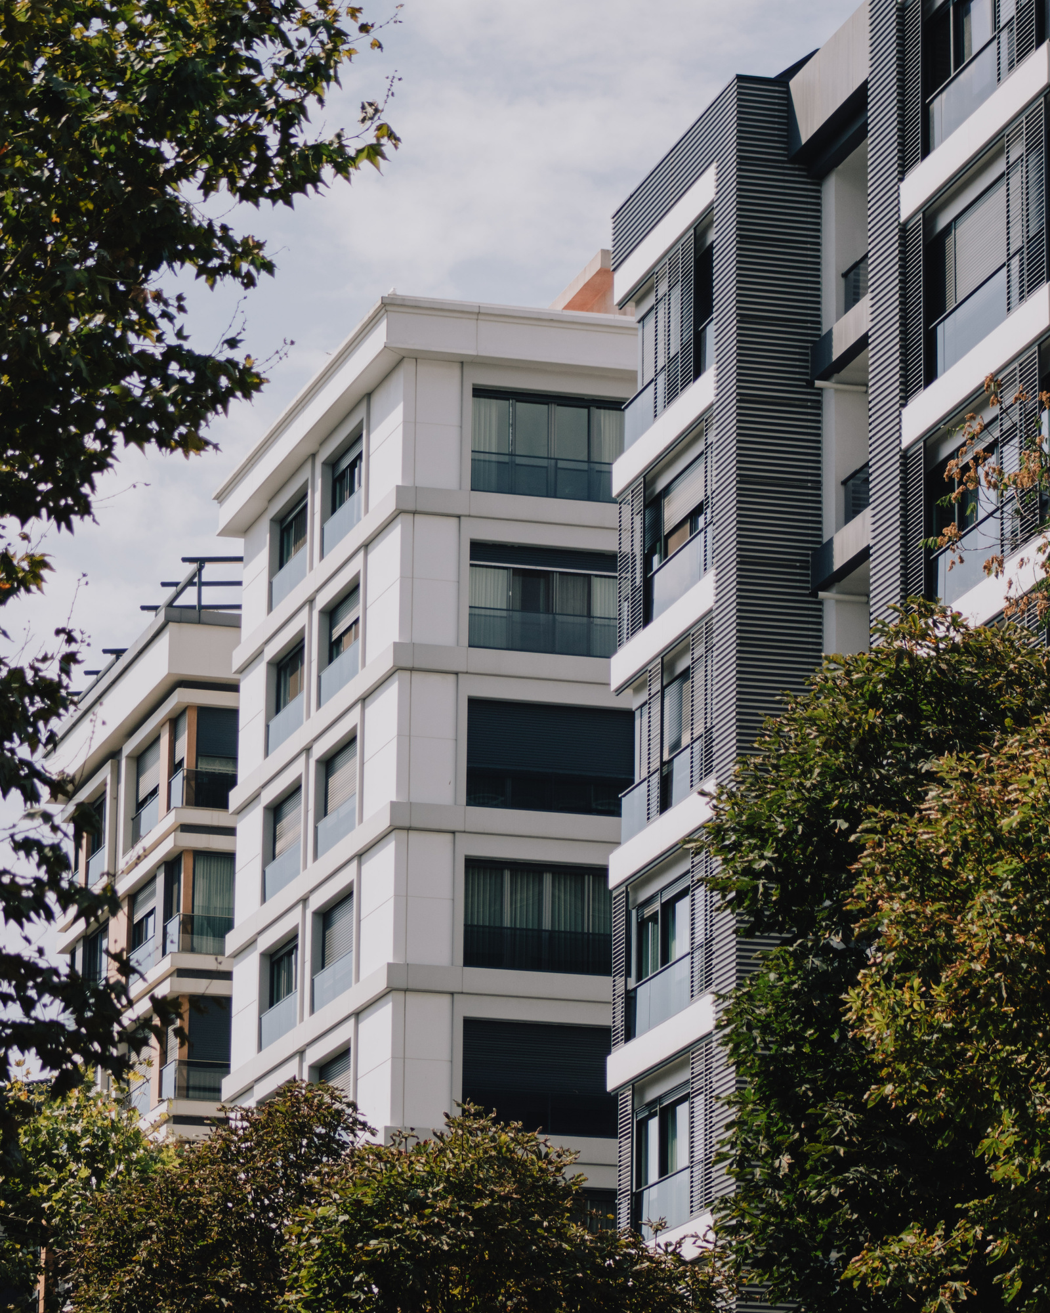






Thank You
Contact Us
01144438800
hassananees188@gmail.com
www.fgffs3444.com
Gerente General

